Slide 1
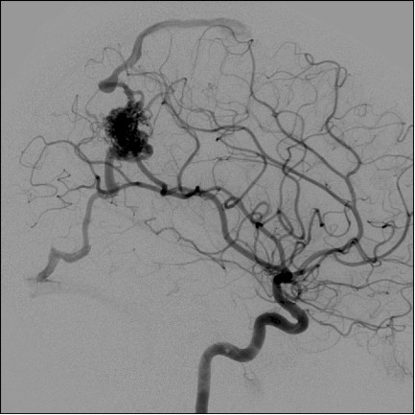
Angiograms an-jee-uh-grams
Fall 2013
Judd, Mike, and Jesse (as in Jesse James)
Facilitators to your learning

Slide 2
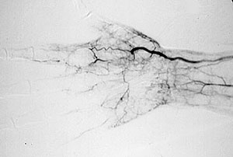
Let us tell you what it is
An angiogram is a diagnostic procedure that provides detailed x-ray images of your heart and its surrounding blood vessels.

Slide 3
Indications for Angiograms
Your doctor may recommend that you have a angiogram if you have:
Symptoms of coronary artery disease, such as chest pain (angina)
Pain in your chest, jaw, neck or arm that can't be explained by other tests
New or increasing chest pain (unstable angina)
A heart defect you were born with (congenital heart disease)
Heart failure
Other blood vessel problems or a chest injury

Slide 4
You are probably wondering how it is done...
Coronary angiography is performed with the use of local anesthesia and intravenous sedation, and is generally not uncomfortable.
In performing a coronary angiogram, a doctor will insert a small tube (catheter) through the skin into an artery in either the groin or the arm.
Guided with the assistance of a fluoroscope (a special viewing instrument), the catheter is then advanced to the opening of the coronary arteries (which supply blood to the heart).

Slide 5
Wait! There is more……
Next, a small amount of radiographic contrast (an iodine based solution, which is easily visualized with X-ray) is injected into each coronary artery. The images that are produced are called the angiogram.
This takes approximately 20-30 minutes from start to finish.
After the procedure, the catheter (tube) is removed and the artery in the leg (femoral) or arm (brachial) is either sutured (sewn), or treated with manual compression to prevent bleeding.
Often, if an angioplasty or stent is indicated, it will be performed as part of the same procedure.

Slide 6
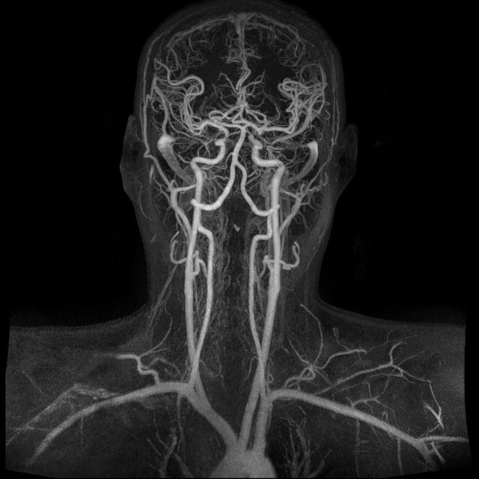
Now that we know what is, Lets talk about nursing for a minute. Now that we know what is, Lets talk about nursing for a minute. Now that we know what is, Lets talk about nursing for a minute. Now that we know what is, Lets talk about nursing for a minute. Now that we know what is, Lets talk about nursing for a minute. Now that we know what is, Lets talk about nursing for a minute. Now that we know what is, Lets talk about nursing for a minute. Now that we know what is, Lets talk about nursing for a minute.
No seriously, Lets talk about nursing for minute!!!

Slide 7
Preoperative
The role of the RN preoperatively includes:
Ensure that the patient does not have iodine or shellfish sensitivity.
Abstain from food and fluids for 6-18 hour before procedure.
Administer sedation as ordered
Inform patient about use of local anesthesia, insertion of catheter, and feeling of warmth when dye is injected and possible fluttering sensation of heart as catheter is passed.
Note that patient may be instructed to cough or take a deep breath when dye is injected and that patient is monitored by ECG throughout procedure.
Shave groin if required

Slide 8
Postoperative Nursing Implications
The role of the RN postoperatively includes:
Assess circulation to extremity used for catheter insertion.
Check peripheral pulses, color, and sensation of extremity every 15 min for 1 hour and then with decreasing frequency.
Observe puncture site for hematoma and bleeding.
Place compression device over arterial site to achieve hemostasis, if indicated.
Monitor vital signs and ECG.
Assess for hypotension or hypertension, abnormal HR, dysrhythmias, and signs of pulmonary emboli (e.g., respiratory difficulty).
Encourage fluids to flush dye

Slide 9
Now that you know about Angiograms….
Grab your Clickers!
Okay, Just pretend…

Slide 10
Q: What is the standard order for Puncture site and Vital sign assessment post-procedure?
A: Assess puncture site and VS q15min X4, q30min X2, q1h X2.
Q: What allergies are important to note before an angiogram is performed?
A: Iodine, Shellfish
Q: Name three signs of an allergic reaction to dye the CCC Registered Nurse should be aware of.
A: Dyspnea, Flushing, Hives, Nausea, Vomiting

Slide 11
Q: What is the most common sensation patients should be made aware of prior to an angiogram?
A: A transient burning and flushing sensation may be felt when the dye is inserted.
Q: What would the CCC Registered Nurse be concerned with assessing after the patients first time OOB after the procedure?
A: The CCC Registered Nurse knows that the puncture site should be checked 10 minutes after activity.

Slide 12
Q: The CCC Registered Nurse knows that when the patient asks “Why do I need an angiogram? What are they looking for?” the correct response is... (Select all that apply)
Aneurysm
Obstruction
Damaged Tissue from MI
Collateral circulation
A: A,B,D
Q: What symptoms displayed by the patient would make the CCC Registered Nurse expect the medical professional to order an angiogram?
A. Abdominal distention with N/V
B. Pain in chest, jaw, neck, or arm
Consistent Temp > 101F for 7 days
D. Pleural Effusion with Bibasilar Infiltrates

Slide 13
Now watch this short video.

Slide 14
EBP- What we learned
The evidence based practice that our group gathered while completing this assignment revolved around the preferred method for cardiac viewing. What we found is that although conventional catheter coronary angiography is the perceived gold standard for assessing coronary anatomy, it gives limited information about the coronary artery vessel wall, may miss early atherosclerotic changes and calcification, is quite expensive, and has a complication rate of 1:1000. With that said, as technology is advancing, CT angiography is slowly moving to the forefront due to the fact that it is less invasive, more cost effective, and allows for better viewing of the vessel wall structure.

Slide 15
In closing, we would like to leave you with one last message

Slide 16
Bibliography
Boyd, D., & HESI (Firm) (2011). HESI Comprehensive Review for the NCLEX-RN Examination (3rd ed.). St. Louis, Mo: Elsevier.
Coronary angiography: MedlinePlus Medical Encyclopedia. (n.d.). Retrieved November 18, 2013, from http://www.nlm.nih.gov/medlineplus/ency/article/003876.htm
Fox, N., Call, A., H. Miller, ,., & J. Leslie, ,. (2012). Computerised tomography coronary angiography. British Journal Of Cardiac Nursing, 7(8), 363-368.
Lewis, S. M. (2011). Medical-surgical nursing: Assessment and management of clinical problems (8th ed.). St. Louis, Mo: Elsevier/Mosby.
Monir, A. (2011, June 30). Coronary-angio.swf [Video file]. Retrieved from http://www.youtube.com/watch?v=C5uV3fAhJo0
Potter, P. A., & Perry, A. G. (2009). Fundamentals of nursing (7th ed.). St. Louis, Mo: Mosby Elsevier.
What Is Coronary Angiography? - NHLBI, NIH. (n.d.). Retrieved November 18, 2013, from http://www.nhlbi.nih.gov/health/health-topics/topics/ca/

