Slide 1
What the PICC?!?
Judd Marshall, Kim Wise, Michael Bilinski

Slide 3
Objectives:
Identify Contraindications of PICC lines.
Identify risk factors with PICC lines.
Identify Nursing considerations for PICC lines.

Slide 5
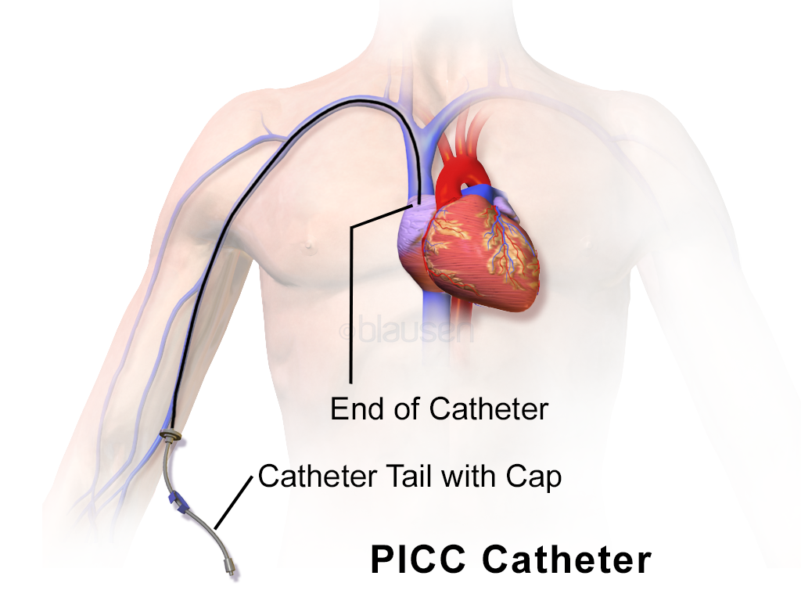
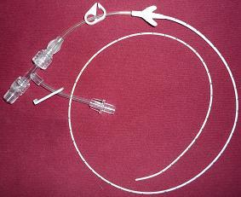
What is a PICC line?!?
Definition: The PICC is a small, soft, flexible, IV line with 1-3 lumens inserted peripherally and led to the superior vena cava and ends just before the right atrium.

Slide 6
Advantages of PICC lines:
Long term placement compared to 3-4 days with a peripheral IV access device.
Medications that may cause discomfort or burning in a peripheral IV will not cause pain or phlebitis.
Blood draws can be performed through a PICC
Reduced risk of infiltration.
Long term patients can be provided medications and treatments from home easily with a PICC.
Multiple lumens allow for multiple medications and treatments to run simultaneously.

Slide 7
Contraindications of PICC lines:
Some patients with implanted defibrillators or pacemakers may not be candidates for PICC lines.
Patients with a P wave that is intermittent, not identifiable, or not present.
Patients with chronic kidney disease.

Slide 8
Restrictions with PICC lines:
No BP cuffs or anything tight over the upper arm that has the PICC in it.
Do not lift anything heavier than 8lbs with PICC arm.
Keep the PICC dressing dry and sealed on all four sides.

Slide 9
Risk’s to consider for PICC lines:
PICC may follow up the jugular vein, or go to far and enter the right atrium causing severe irregular heartbeats. Chest X-ray is always done to check placement.
PICC line may break off while in the arm or when being removed.
Air embolism.
Thrombus formation.
Increased risk for infection.

Slide 10
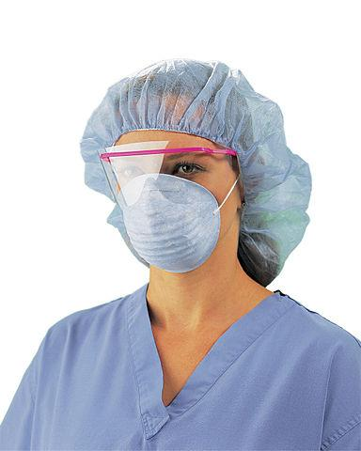
Nursing Considerations for PICCs:
Infection control: Proper technique when changing dressings is imperative to decrease the risk of infection.

Slide 11
Proper PICC line dressing change:
Explain procedure to patient
Gather equipment
Wash hands
Don hair cover, mask, clean gloves
Open sterile drape and place all sterile items on drape. Have Pt turn head.
Slowly and gently remove old IV tegaderm dressing. Be careful not to dislodge or pull out the PICC line. Remove securement device.

Slide 12
Proper PICC line dressing change:
Discard gloves, repeat handwashing, don sterile gloves.
Scrub around the PICC insertion site and the catheter with the chloroprep scrub for 30 seconds and allow to air dry.
Inspect insertions site, external catheter, and hubs.
Secure PICC catheter into the securement device. Do not kink, twist, or overlap on itself. Secure to arm.

Slide 13
Proper PICC line dressing change:
Place biopatch (with blue side up) at the insertion site with catheter through the slit and remains on top of the patch.
Cover entire area starting just above the insertion site with the IV transparent dressing, securing it on all sides.
Use extra taping available to secure dressing and catheter.
Clamp each lumen. Remove needleless connectors. Clean with ETOH (15/15).

Slide 14
Proper PICC line dressing change:
Attach a 10ml NS flush to new connector, flush connector, and connect to each of the lumens.
Release clamps and flush each lumen with Pulsating action and assess if blood return present.
Label dressing with name, date, and time.
Wash hands
Document.

Slide 15
S.A.V.E. THAT LINE!
Scrupulous hand hygiene. (Before and after contact with PICC and prior to insertion).
Aseptic technique during catheter insertion and care.
Vigorous friction to catheter hub prior to entry. (Vigorous friction with ETOH whenever you “make or break a connection”)
Ensuring patency of the device. (Flush all lumens with adequate amount)

Slide 16
Nursing Implications:
Always check your facility for current policies and procedures. Some examples are:
Flushes: Q12Hr with 10cc NS and PRN. EBP suggest checking at least Qshift for patency.
Hickman: Flush with Heparin.
Groshond: Flush with Normal Saline.
Remember to flush ALL lumens in PICC!

Slide 17
Nursing Implications:
Dressing changes Q7Days and PRN
IV tubing: changes Q3Days and PRN
Date time initial dressing changes and tubings.
EBP suggest changing needleless connectors after blood draws.

Slide 18
Nursing Implications:
Scrub the hub: 15 seconds scrub with ETOH and 15 seconds to allow for drying.
Red caps: Always red cap lines when not in use. Never close on self.
Assess for SS of phlebitis and infiltration.
Use the SAS method (or SASH for Hickman PICC)

Slide 19
!IMPORTANT NOTE!
Nursing care is an ever changing process. Be sure to stay up to date with your facility’s policies and procedures.

